Slide 1
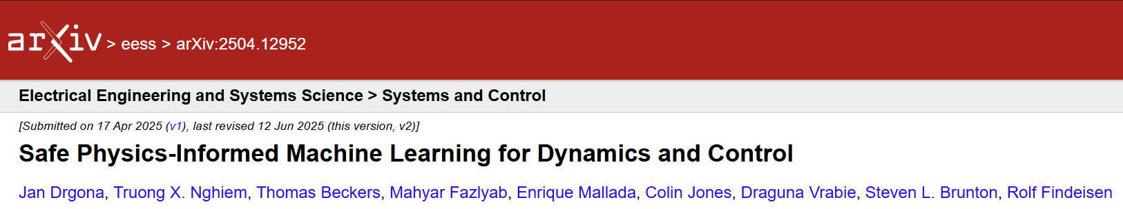
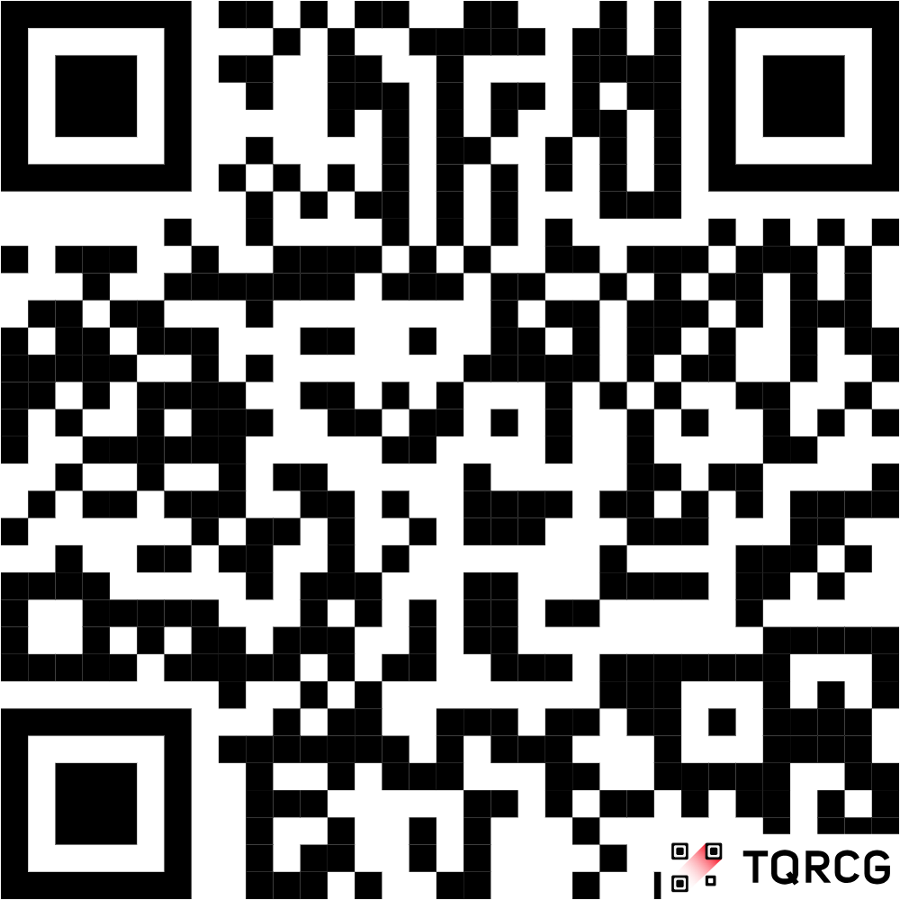
II. SAFE LEARNING FOR DYNAMICS
Stability Guarantees
Constraints Satisfaction
Uncertainty Quantification
III. SAFE LEARNING FOR CONTROL
Learning-based Model Predictive Control and Predictive Safety Filters
Control Barrier and Control Lyapunov Functions
IV. SAFETY VERIFICATION METHODS
Reachability Analysis Methods
Constrained Optimization-based Methods
Simulation and Sampling-based Methods
V. CHALLENGES AND OPPORTUNITIES
arXiv:2504.12952

